Slide 1
RevOps Data Analyst: From Data to Decision
Strategic Vision & Technical Execution for PTV Logistics
Svitlana Kovalivska, 14.01.2026

Slide 2
Profil & Fokus:
about me

Slide 3
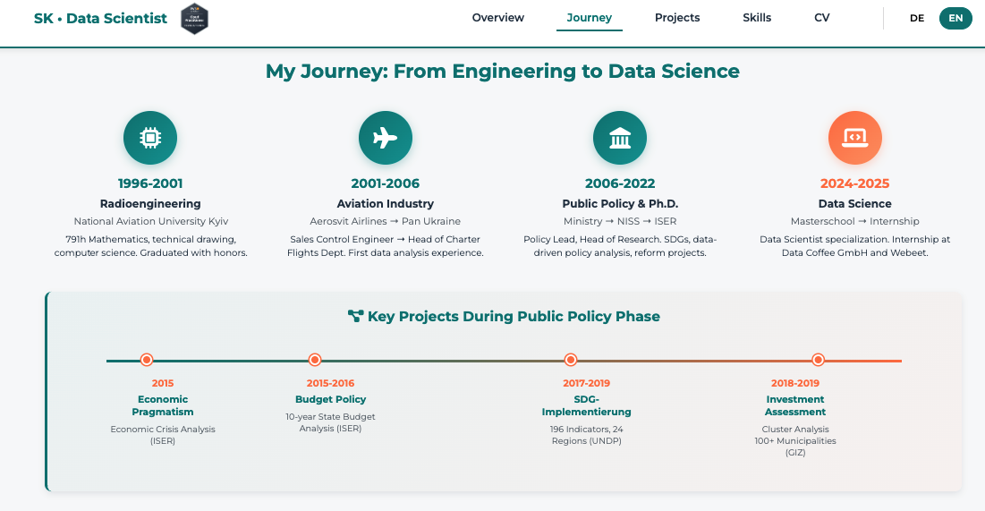
Portfolio

Slide 4
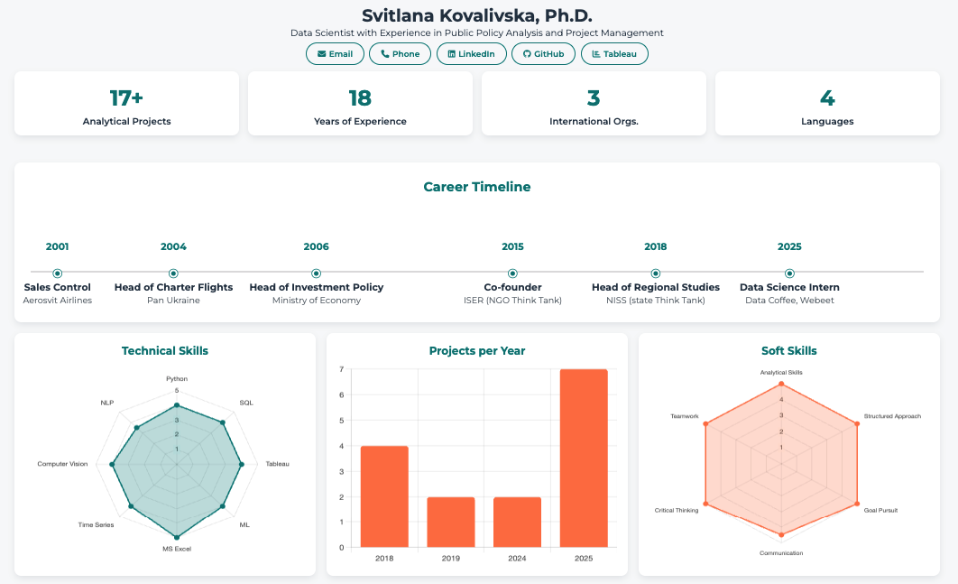
Portfolio

Slide 5
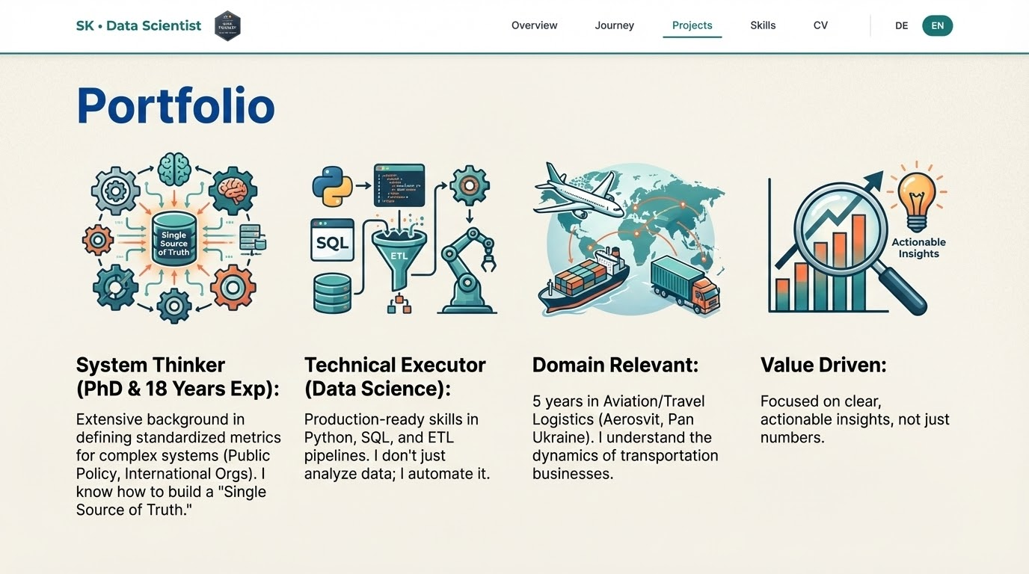

Slide 6
The Match (Requirements vs. Skills)
PTV Logistics Requirement | My Expertise & Tools
Standardized KPI Framework | Project: Agricultural KPI System. Designed 40+ unified metrics for production efficiency. Used strictly defined logic for "Single Source of Truth."
Funnel & Conversion Analysis | Project: Metrocar Funnel Analysis. Analyzed customer journey steps, drop-off points, and platform-specific conversion rates.
Python & SQL Automation | Project: Enterprise ETL Toolkit. Built automated pipelines (Python/PostgreSQL) to clean and validate data across multi-cloud environments.
Dashboarding & Reporting | Viz Tools: Expert in Tableau & Streamlit. Transferable skills to Power BI, Looker Studio etc. Focus on actionable visualization for leadership.

Slide 7
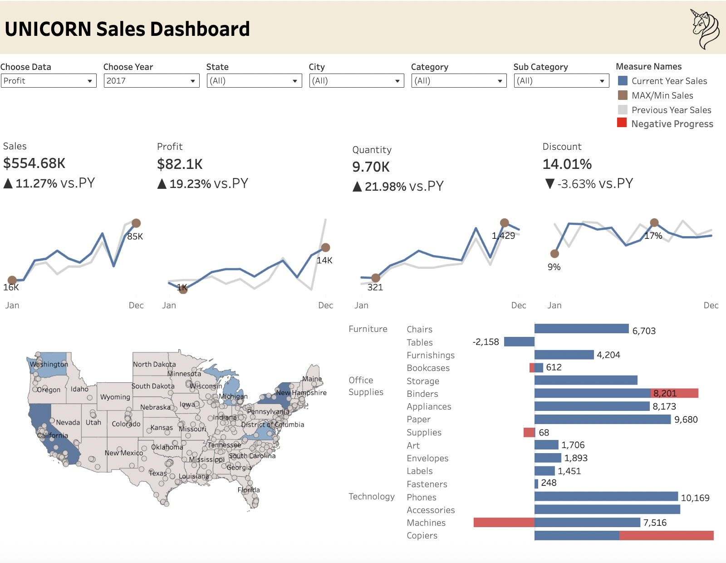
Experience: Building a "Single Source of Truth" Case Study: Production KPI System
Project
Agricultural Production KPI Analytics (Data Coffee GmbH)
GitHub
Sales Performance Analysis
GitHub Tableau Dashboards
Challenge: Disconnected data sources and inconsistent metric definitions.
Solution: Developed a unified analytical model with 40+ standardized KPIs.
My Approach:
Strict Definitions: Defined what counts (numerator/denominator) to ensure consistency.
Data Integrity: Implemented SQL validation rules to catch anomalies early.
Result: A scalable reporting system that reduced manual monitoring effort by ~80% (potential).
Relevance to RevOps:
I will apply this same rigour to your Bowtie metrics ensuring Sales, Marketing, and CSM speak the same language.

Slide 8
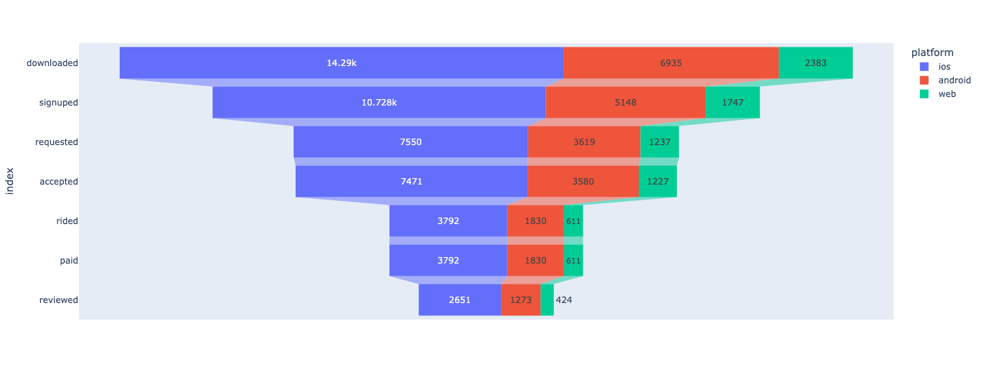
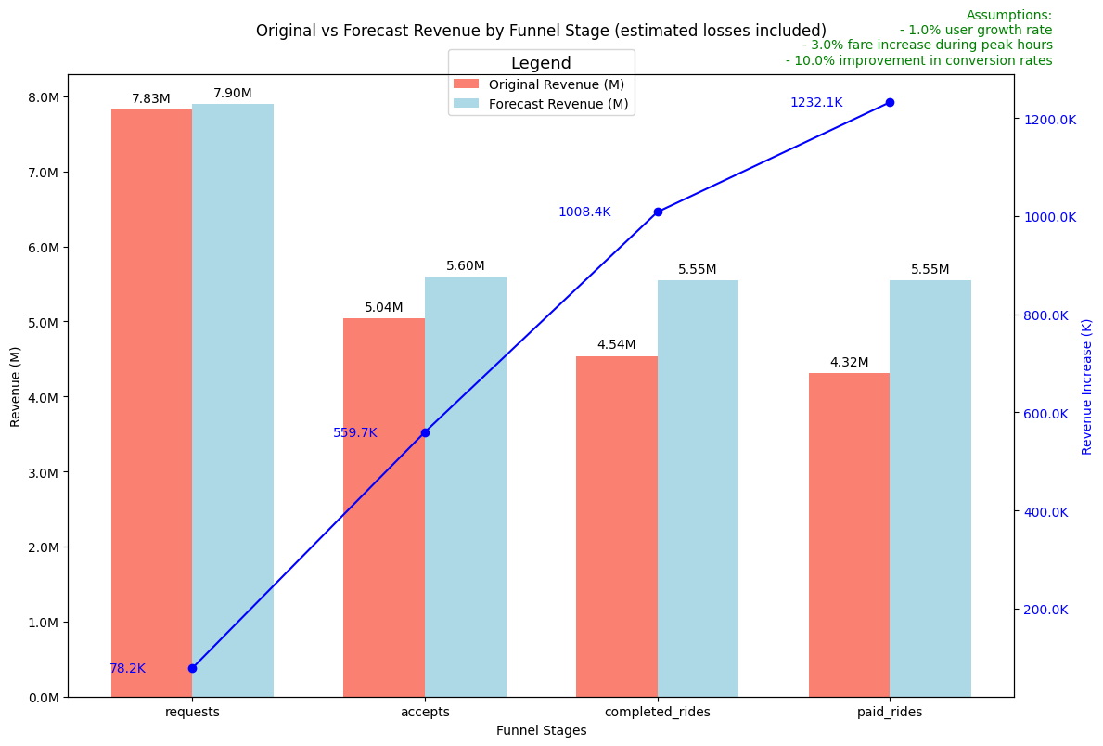
Experience: Funnel & Trend Detection Case Study: Metrocar Customer Journey
Project
Metrocar Funnel Analysis
GitHub
Scope: Analyzed the full lifecycle: App Download → Signup → Ride Request → Ride Accepted → Ride Completed → Payment → Review
Key Insights: Identified a critical drop-off point between "Ride Request" and "Ride Accepted" (Supply/Demand mismatch).
Methodology:
Cohort Analysis: Segmented by platform (iOS/Android) and age groups.
Leakage Detection: Pinpointed exactly where users were leaving the funnel.
Relevance to RevOps:
I will use this approach to analyze your Stage-to-Stage conversion, identify friction points, and improve Velocity.

Slide 9
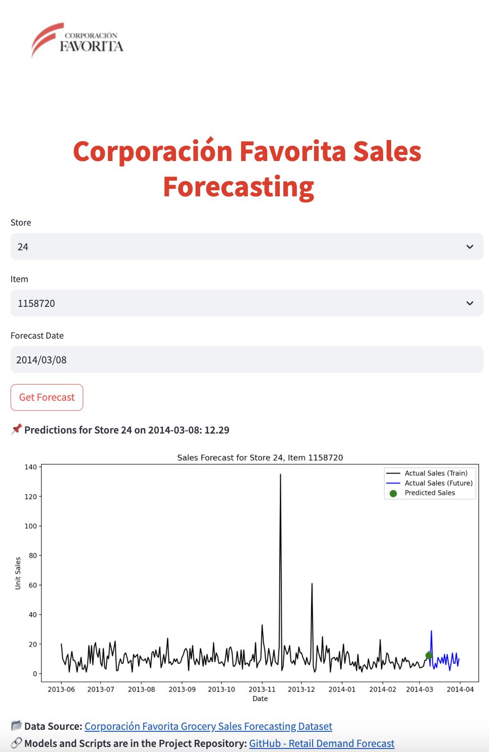
Predictive Analytics & Demand Forecasting
Projekten
Retail Demand Forecast GitHub LocalStreamlit
Time Series Prediction
GitHub Streamlit
Data Scope:
Sales Time-Series Data.
Analysis of Seasonality, Trends, and External Drivers (features).
Methods & Tech Stack:
Statistical Models: ARIMA, SARIMAX, Prophet.
Machine Learning: XGBoost, LSTM (Deep Learning).
Techniques: Advanced Feature Engineering, Time-Series Cross-Validation.
Key Results:
Benchmarking: Rigorous comparison of multiple models to identify the best performer.
Stability: Achieved reliable forecasts despite market volatility.
Impact: Provided the foundation for data-driven Inventory & Supply Chain decisions.

Slide 10
The Strategic Insight (Power Law v.s. Normal Distribution)
Strategic View: Analyzing PTV as a B2B SaaS

Slide 11
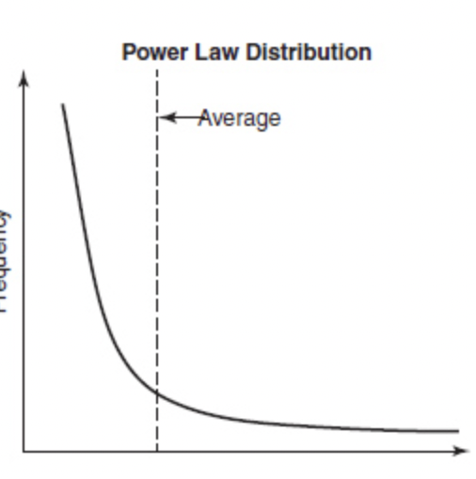
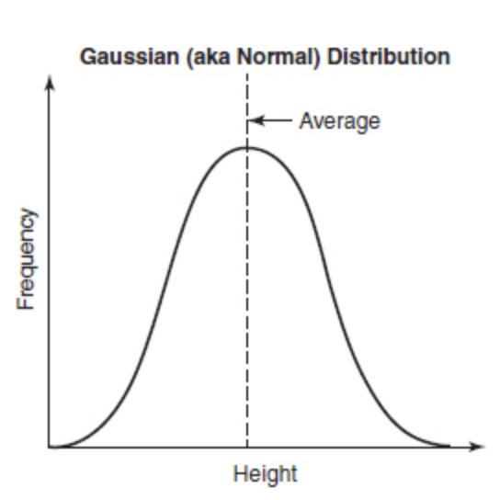
Strategic Context:
The Physics of Your Revenue
My Assessment:
PTV Logistics operates under the Power Law.
Revenue Concentration: Enterprise deals vs. SMBs.
Network Effects: Data accuracy grows with user volume.
Impact: Treating all clients as "average" is a strategic risk.
Normal Distribution (The "Average" World)
Examples: Height, Aviation, Manufacturing, traditional Business (e.g., B2C, Retail)
Dynamics: Events cluster around the average. Stability is the norm.
Strategy: Optimize the mean.
Power Law (The "SaaS" World)
Examples: Earthquakes, Venture Capital, Enterprise Software.
Dynamics: Extreme outliers drive the outcome. "Winner takes most."
Strategy: Scale the outliers.

Slide 12
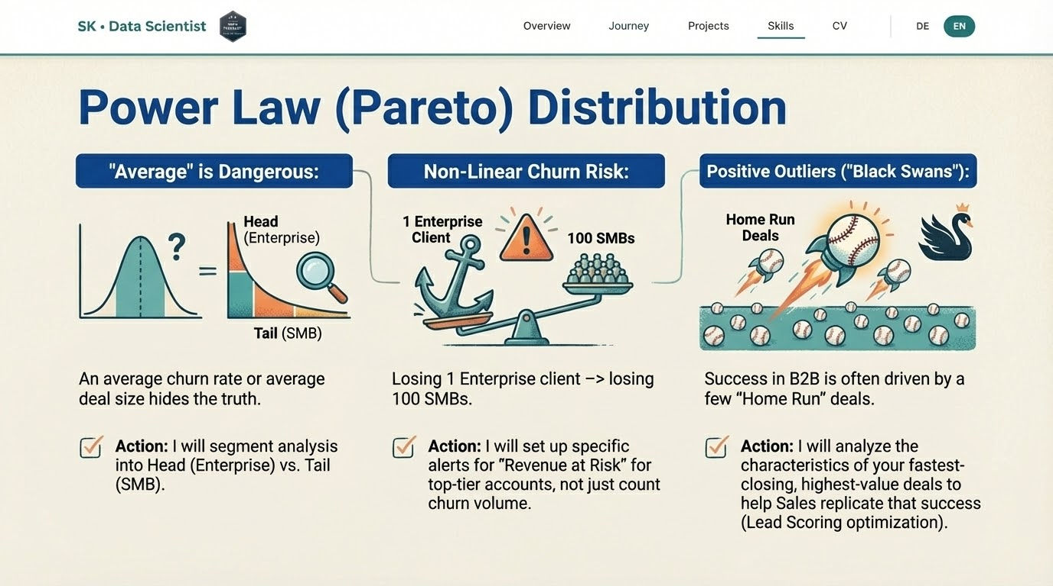

Slide 13
​​Operational Philosophy

Slide 14
Methodology: Monitoring Health vs. Driving Growth
Aligning PTV’s Data Strategy with Business Outcomes
My Approach:
I don't just report numbers. I use KPIs to diagnose issues and help Leadership set data-driven OKRs to solve them.
1. The Dashboard (KPIs)
Role: Measure Health & Stability.
Focus: The Bowtie Framework. Ensuring standardized definitions across Sales, Marketing, CSM.
My Approach: "Is the system working?"
Example: Monitoring Churn Rate stability.
2. The Engine (OKRs)
Role: Drive Change & Strategy.
Focus: Funnel Optimization. Fixing the "leakage points" identified in the data.
My Approach: "How do we improve?"
Example: Reducing Enterprise Churn by 5% via predictive alerts.
Notes:
.

Slide 15
My Plan:
Month 1: Audit & Map.
Deep dive into current KPI definitions (Are Marketing and Sales measuring 'MQL' the same way?).
Map the data flow between CRM and Data Warehouse.
Month 2: Standardize & Build.
Document the "Bowtie" metric logic.
Build the first "Power-Law focused" dashboard (segmenting Enterprise vs. SMB).
Month 3: Optimize.
Identify one major "Leakage Point" in the funnel.
Present actionable insights to leadership to improve conversion velocity.
First 90 Days

Slide 16
Summary: Ready to Drive Revenue Efficiency
Technical: Python, SQL, KPI Design, Dashboarding.
Strategic: Power-Law Mindset, System Thinking.
Motivated: Passionate about Logistics and clear, honest data.
Thank you!
Svitlana Kovalivska

